Slide 1

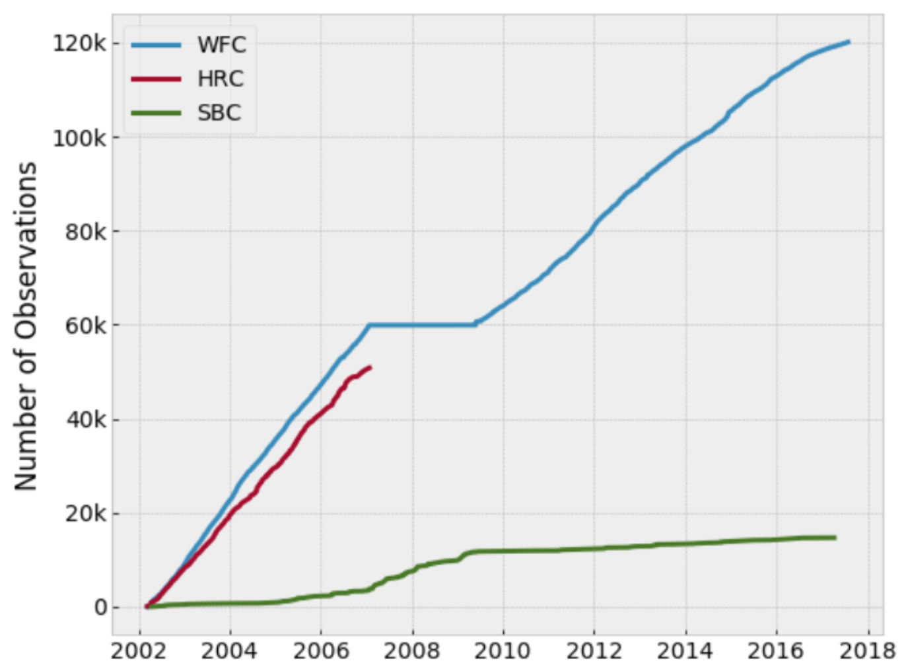
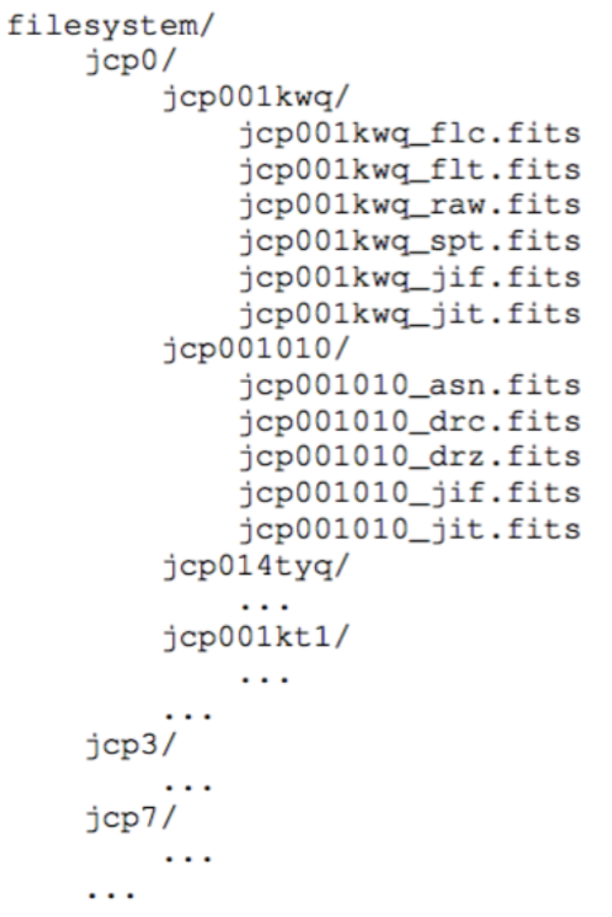
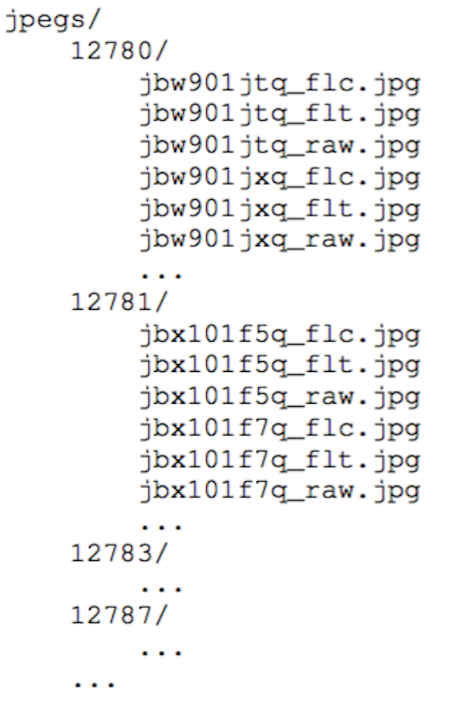
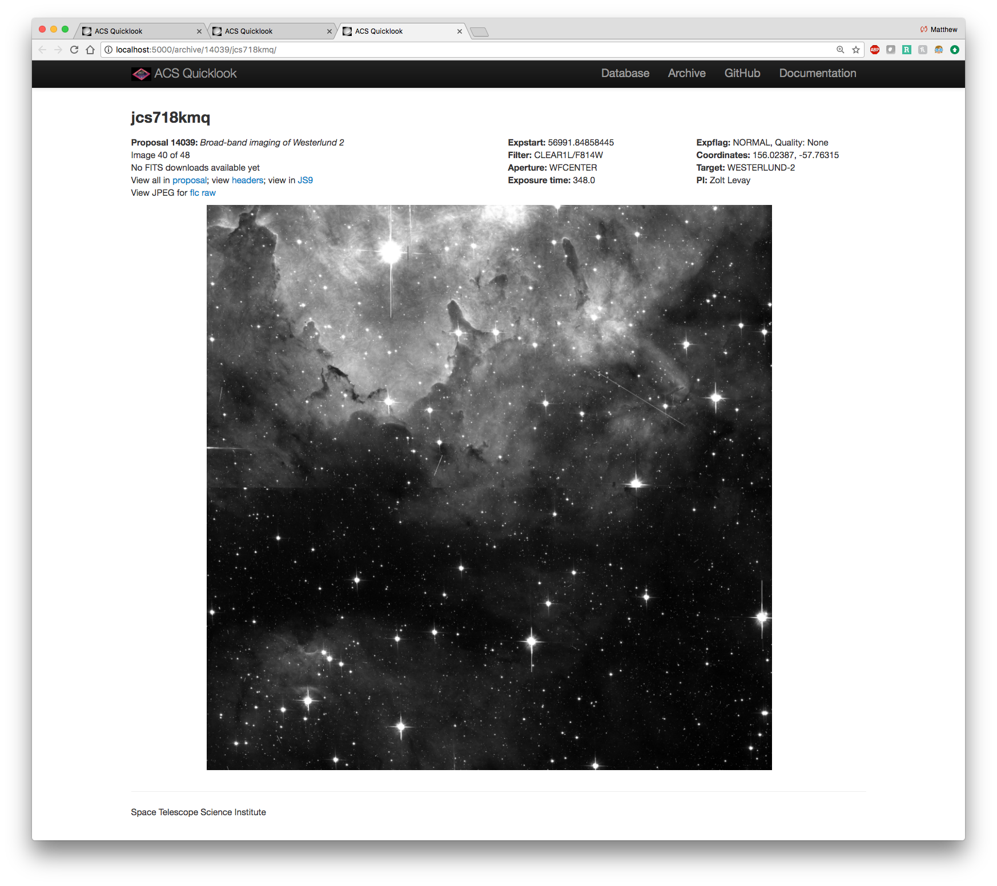
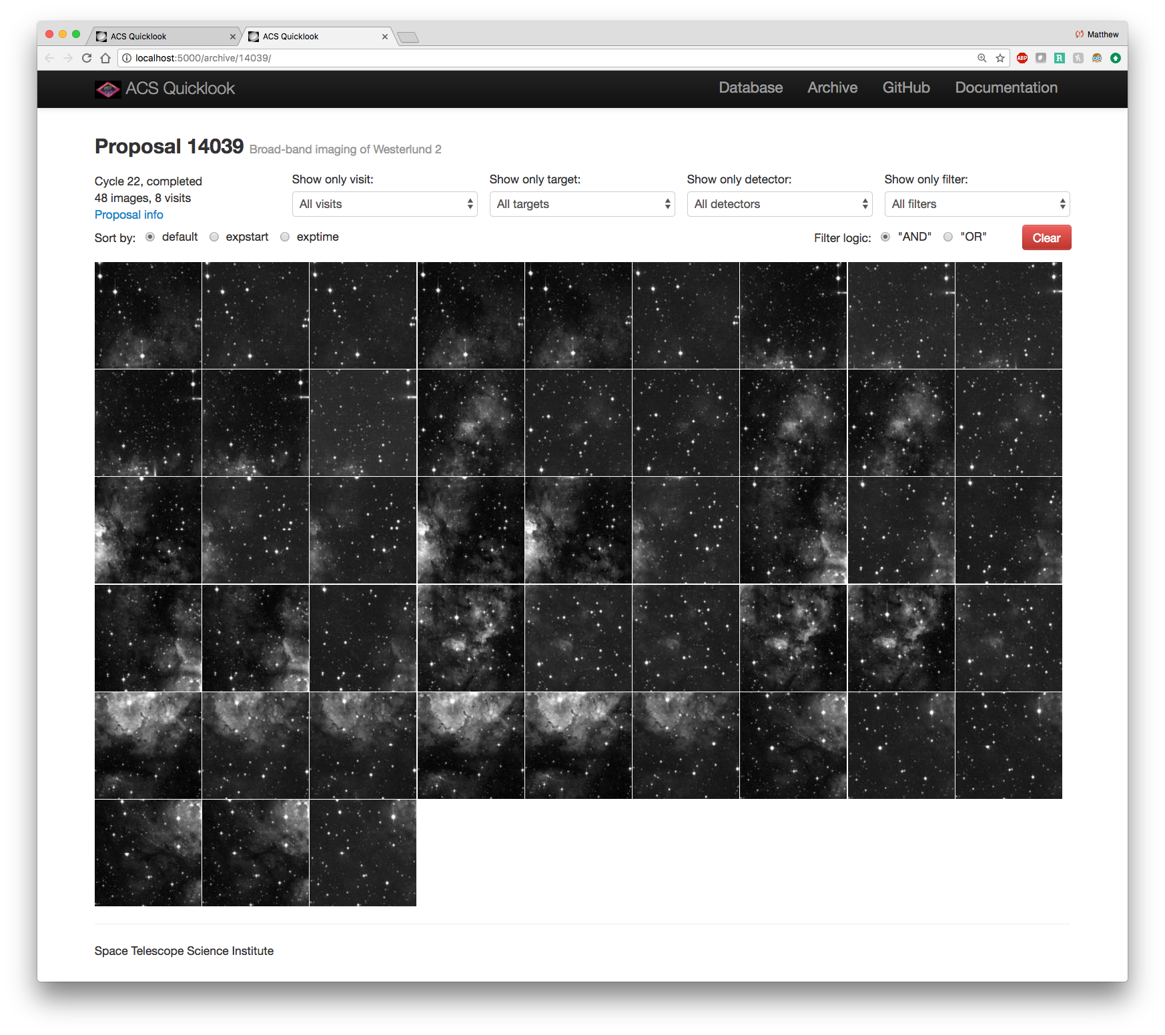
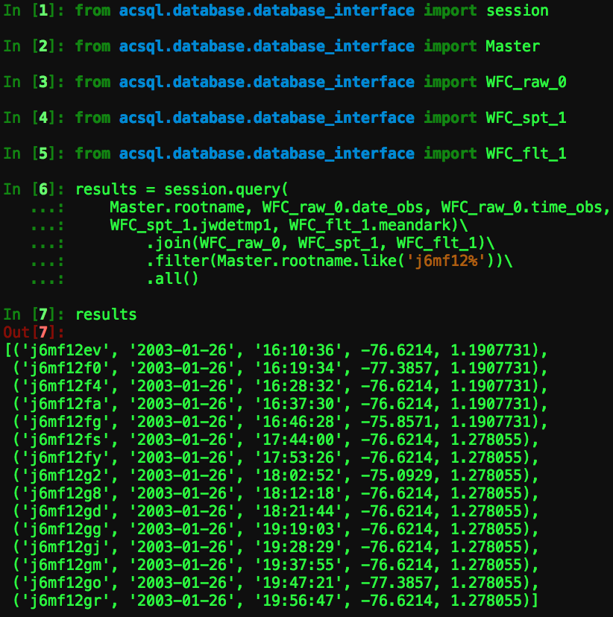
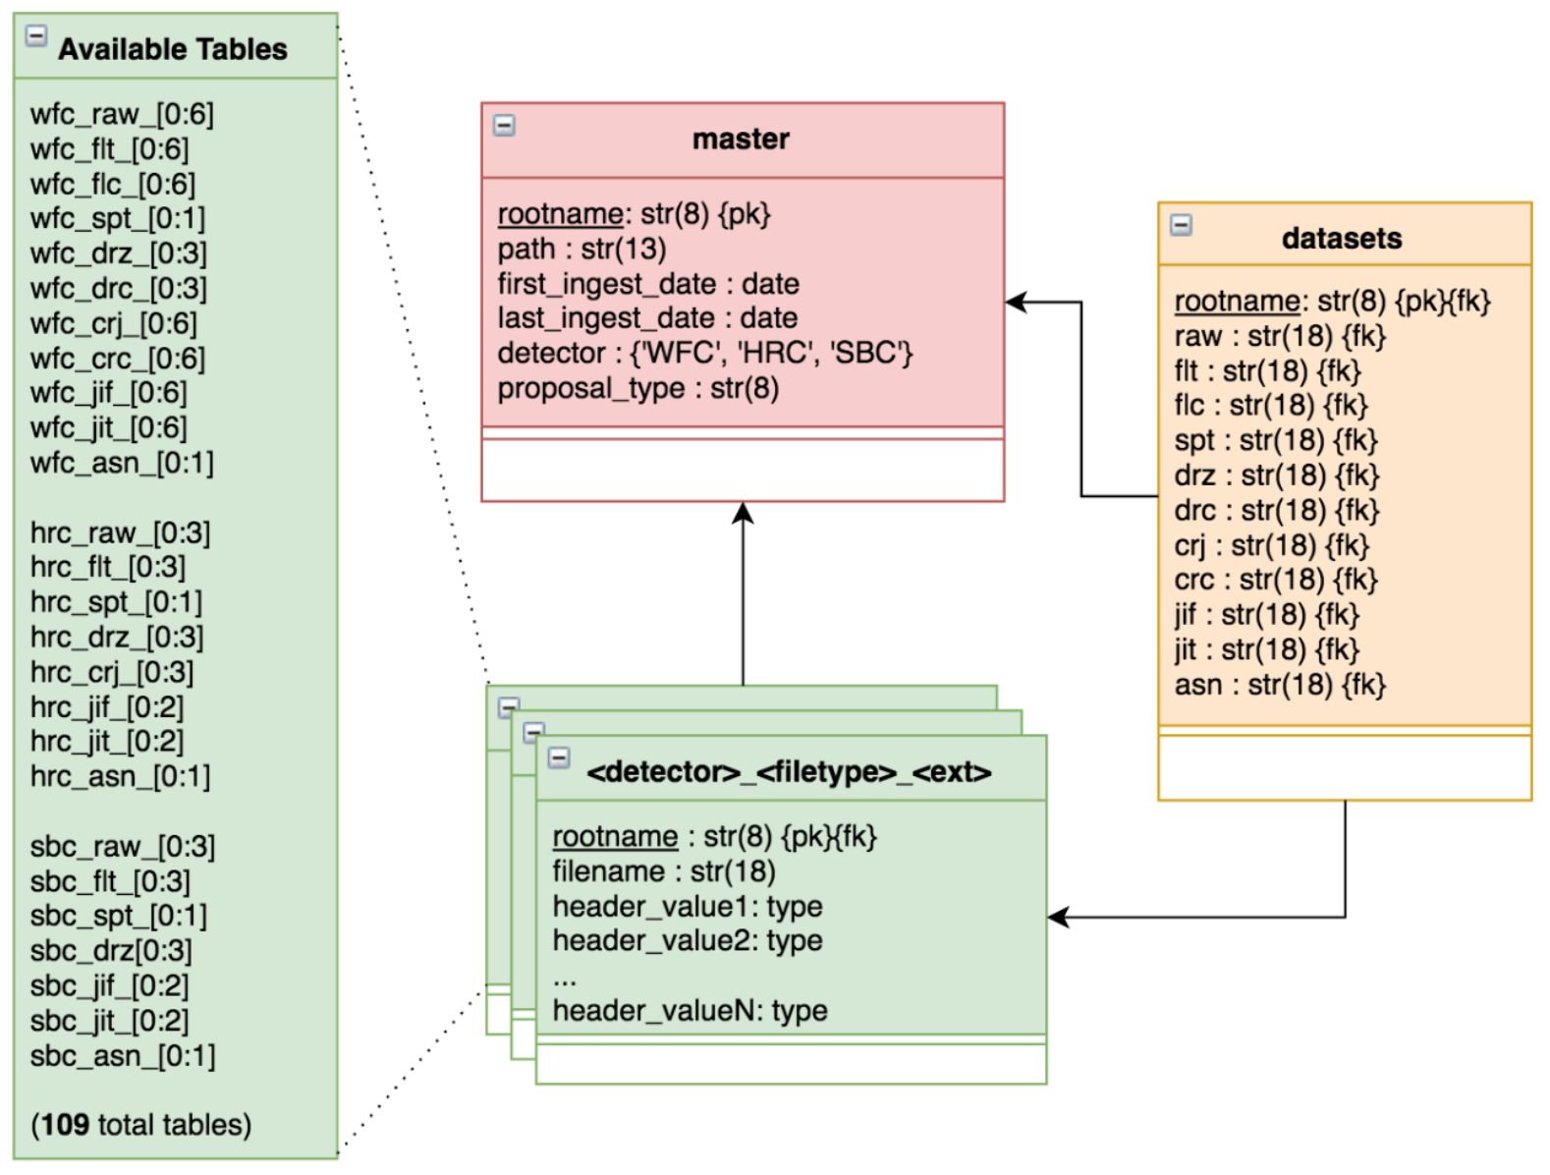
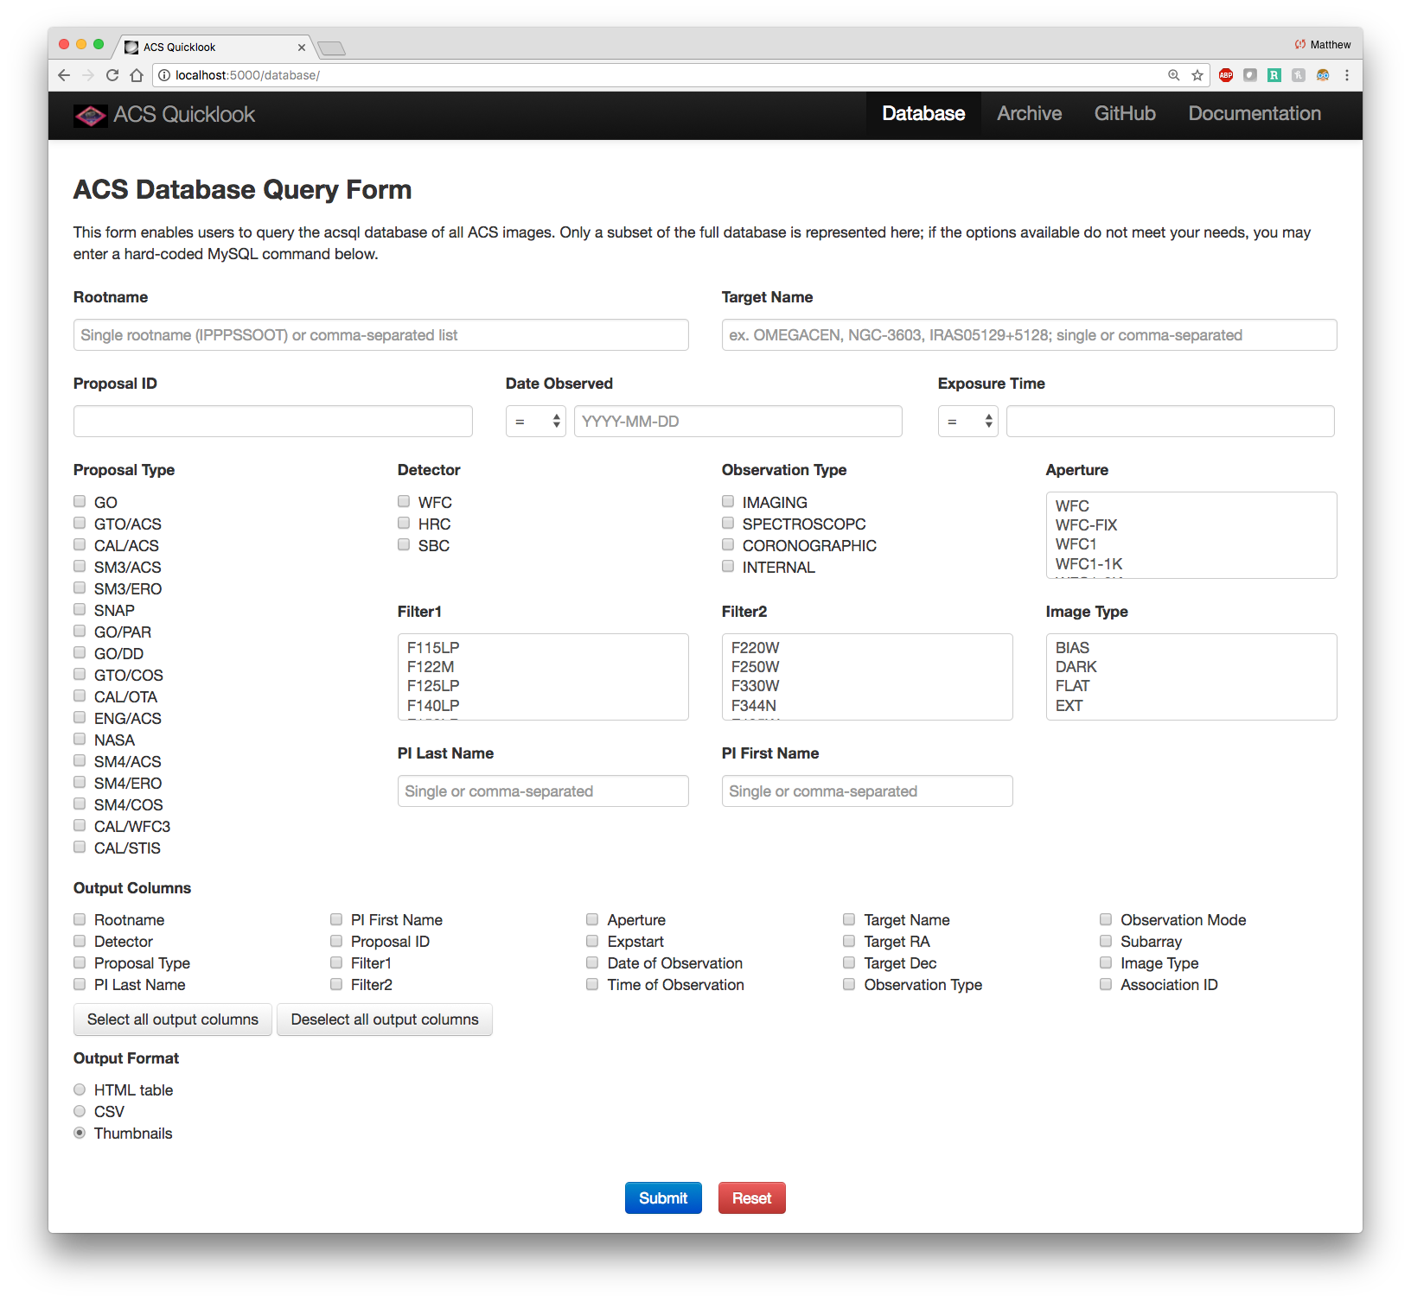





The Hubble Space Telescope Advanced Camera for Surveys Quicklook Application
Matthew Bourque[1], Sara Ogaz[1], Alex Viana[2], Meredith Durbin[3], Norman Grogin[1]
The Hubble Space Telescope (HST) Advanced Camera for Surveys (ACS) instrument has been acquiring thousands of images each year since its installation in 2002 (via Servicing Mission 3B) and subsequent restoration in 2009 (via Servicing Mission 4). The ACS Quicklook project (acsql) provides a means for users to view all on-orbit ACS image and header data through a browser interface, an API to build custom datasets through relational queries, and a platform on which to build automated instrument calibration and monitoring routines. This is accomplished through the various system components: (1) a ~40 TB filesystem, which stores all publicly-available ACS data on disk, (2) a MySQL database, which stores all publicly-available FITS header data for each ACS filetype and header extension, (3) a Python/Flask-based web application, which allows users to navigate and display any public ACS archival data, and (4) a Python software package, which serves as the filesystem, database, and website API. ACS Quicklook is intended to be extended to support the forthcoming James Webb Space Telescope mission.
Filesystem
Web Application
The acsql filesystem contains all publicly-available on-orbit ACS data from each of its three detectors: The Wide Field Camera (WFC), the High Resolution Channel (HRC) and the Solar Blind Channel (SBC). The filesystem is organized based on the 9-character observation rootname. It also contains “Quicklook” JPEGs for each image, organized by the 5-digit Proposal ID.
The acsql web application (right) allows users to interact with the filesystem and database through a browser interface. Users may view images for any archival ACS observations along with informative metadata, as well as perform queries on the acsql database.
Database
The acsql database is a MySQL database constructed using Python, SQLAlchemy, and the relational schema above. The database stores observational metadata taken from the headers of each ACS FITS filetype and FITS extension for all publicly-available ACS observations. The database_interface Python module provides a programmatic means to perform relational queries on the database.
Software Package
All source code and supporting materials for the acsql application are open-source and available on GitHub. API documentation and installation instructions are available on ReadTheDocs.
github.com/spacetelescope/acsql
acsql.readthedocs.io
[1] Space Telescope Science Institute, Baltimore, Maryland, USA
[2] Terbium Labs, Baltimore, Maryland, USA
[3] University of Washington, Seattle, Washington, USA

